Slide 1
COMPUTER SCIENCE 3A MINI PROJECT
Graph-Based Maze Solver
and Pattern Similarity Analyzer
University of Johannesburg • 2026
Dikgale Mmipe Branden
224097183
Siyanda Brian Nkosi
221123990
Mathiba Mantji Sarah
221022135
Siyabonga Gift Mzimela
222224016

Slide 2
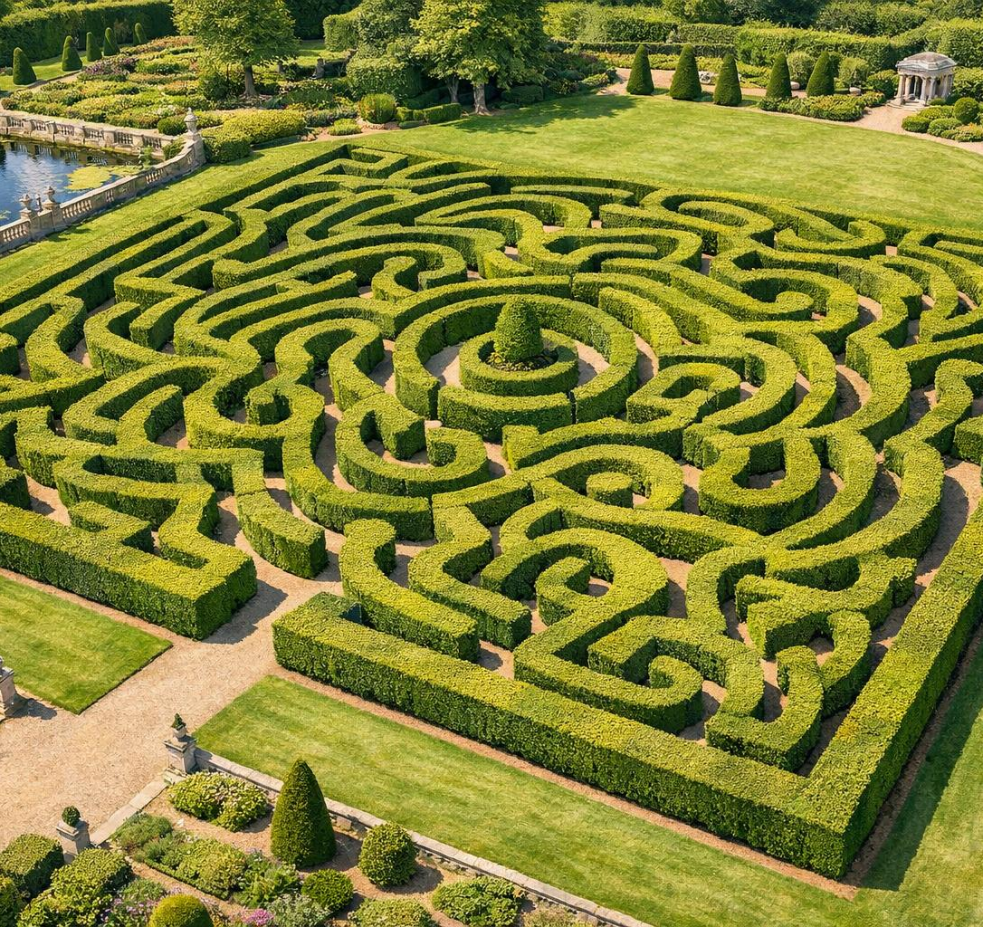
Problem Statement
Real-World Navigation Challenges
Many real-world systems require efficient navigation through complex environments, which includes
Robotics
Vehicles
Autonomous navigation
Self-driving cars
GPS Systems
Emergency
Route planning
Evacuation systems
Network Routing
Optimal path computation
Traditional image processing methods often struggle to model spatial relationships effectively.
Our project addresses this problem by using graph-based image analysis to:
Solve navigation paths
Analyze structural similarity between maze patterns

Slide 3

Project Objectives
Core Goals & Deliverables
Image Processing
Convert maze images into graph structures with dynamic node and edge generation
Pathfinding
Solve mazes using A* and Dijkstra's algorithms to find optimal paths
Similarity Detection
Detect structural similarity between different maze patterns using graph comparison
Visualization
Visualize graph traversal and shortest paths with interactive graphical representation

Slide 4
System Overview
Architecture & Workflow
Maze Solving Process
Similarity Detection
1
Maze Comparison
Upload multiple maze images
1
Maze Image Upload
User uploads maze image to application
2
Feature Extraction
Extract graph structure features
2
Image Processing
Convert image to binary representation
3
Similarity Analysis
Compare graph structures
3
Graph Construction
Generate nodes and edges from paths
4
Score Output
Display similarity percentage
4
A* / Dijkstra Algorithm
Compute shortest path solution
Application GUI
Interactive desktop interface for all operations

Slide 5
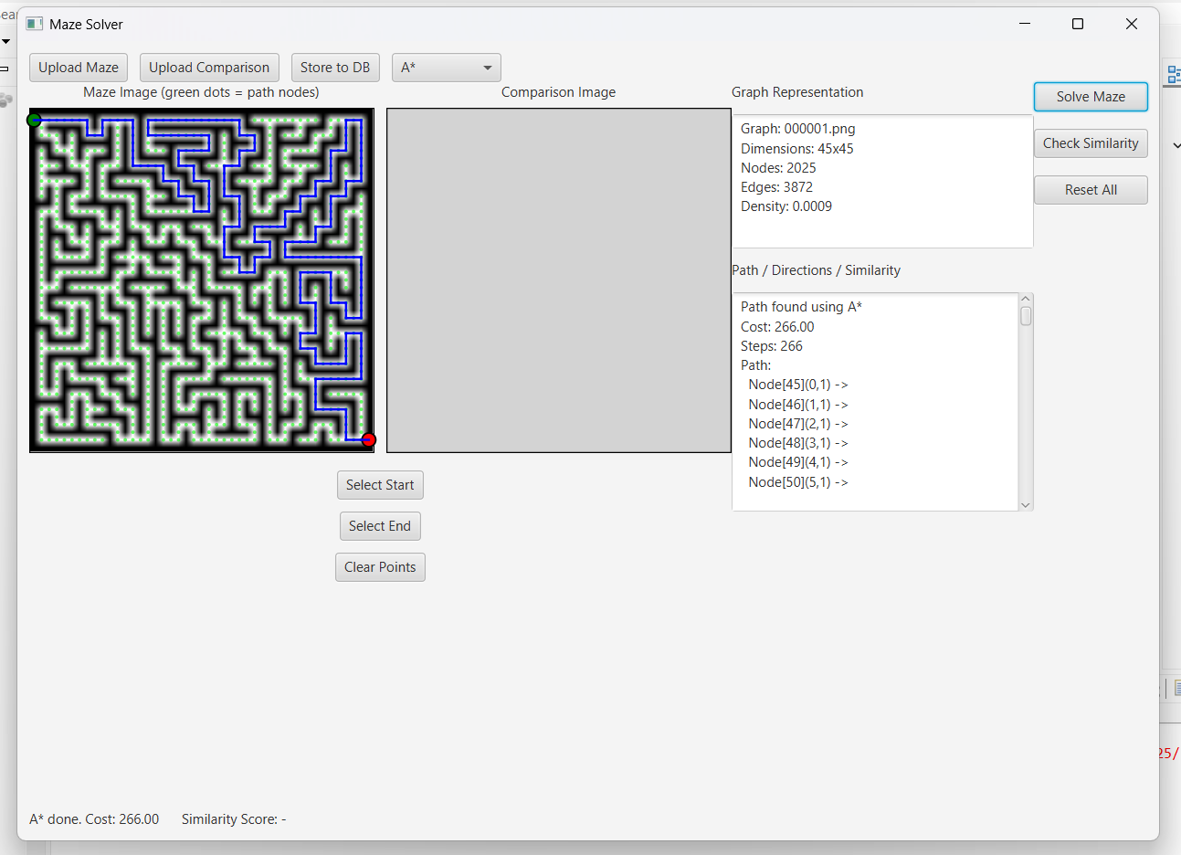
System Overview
Architecture & Workflow

Slide 6
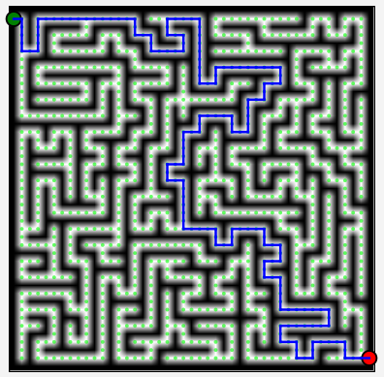
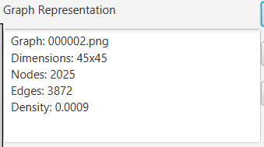
Graph Representation
Core Graph Structure
Graph Components
Nodes
Represent valid walkable positions inside the maze. Each node stores coordinates and connectivity information.
Edges
Represent valid movement connections between neighboring nodes. Weighted edges indicate traversal cost.

Slide 7
Algorithms Used
Core Algorithms
A* Algorithm
Dijkstra's
Similarity
Heuristic pathfinding
Guaranteed optimal path
Graph comparison
Efficient Search
Optimal Solution
Structural Analysis
Finds the shortest path efficiently
Guarantees the shortest path between any two nodes
Compares graph topology and node-edge relationships
Smart Navigation
Similarity Score
Uses heuristics to optimize traversal
Quantifies pattern similarity with numerical output
Pattern Matching
Identifies maze families with similar structural properties
Best for: Complex mazes with clear start/end
Best for: Weighted graphs, guaranteed accuracy
Best for: Pattern grouping, maze classification

Slide 8
Data Structures Used
Custom Implementation
Important: All core data structures were implemented manually in Java without external libraries
Graph
Graph Nodes
Graph Edges
Linked List
Main structure containing nodes and edges
Individual vertices with coordinates
Connections with weights
Dynamic node storage
Queue
Stack
Priority Queue
Hash Map
BFS traversal operations
DFS traversal operations
A* and Dijkstra's ordering
Fast node lookup by coordinates
Graph traversal support
Pathfinding operations
Node storage & retrieval
Similarity analysis

Slide 9

Technologies Used
Technology Stack
Development Stack
Application Features
Upload maze images
Select start/end points
Solve maze dynamically
Compare similarities
Java
Core programming language for all algorithms and data structures
Visualize graph traversal
JavaFX
Graphical user interface framework for desktop application
Eclipse IDE
Development environment for coding and debugging

Slide 10
Benefits and Impact
Value & Applications
Key Benefits
Real-World Applications
Practical Graph Applications
Demonstrates real-world use of graph theory concepts
Robotics
Autonomous Vehicles
Autonomous navigation systems
Self-driving path planning
Efficient Navigation
Image-based pathfinding with optimized algorithms
GPS Routing
AI Navigation
Interactive Visualization
Smart route optimization
Intelligent pathfinding agents
Visual representation of algorithm operations
Dynamic Generation
Emergency Evacuation
Real-time graph creation from any maze image
Optimal evacuation route planning

Slide 11
Demonstrations

Slide 12
Thank you for your attention
University of Johannesburg • Computer Science 3A • 2026

